Slide 1
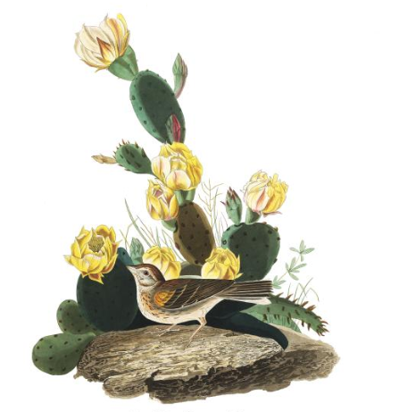
Linking avian pollination and frugivory to Cactaceae seed dispersal and successful facilitation.
Malory Owen
Master’s Thesis Proposal
Principal Investigator: Dr. Chris Lortie
Committee: Dr. Chris Lortie & Dr. Bridget Stutchbury

Slide 2
Positive Interactions in the Desert
Positive Interactions
Facilitation
Foundational species
Keystone species
Benefactor/protege
Desert Ecosystems
Provides water and shade
Protects against herbivory, wind, and freezing temperature
Seeds must get to benefactor
Notes:
A positive interaction is where by the associating between two (or more) interspecifics, at least one’s relative fitness is increased. Usually referred to by the pathway that the interaction follows: plant-plant, plant-animal, plant-plant-animal, plant-animal-plant, etc.

Slide 3
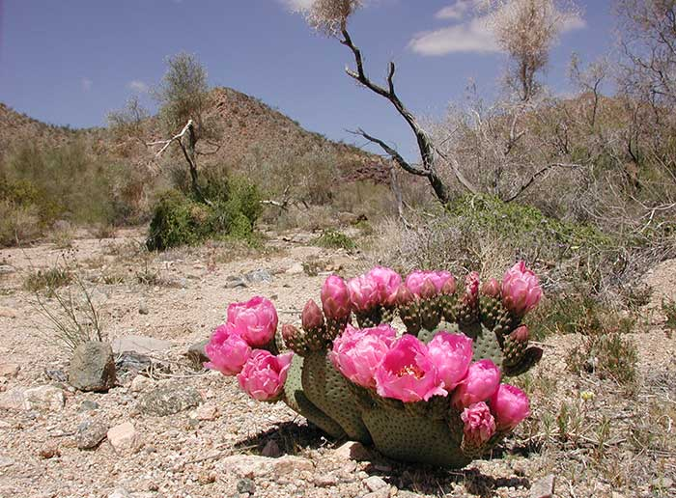
Pollination
Magnet Species Hypothesis
Notes:
One factor that is important for

Slide 4
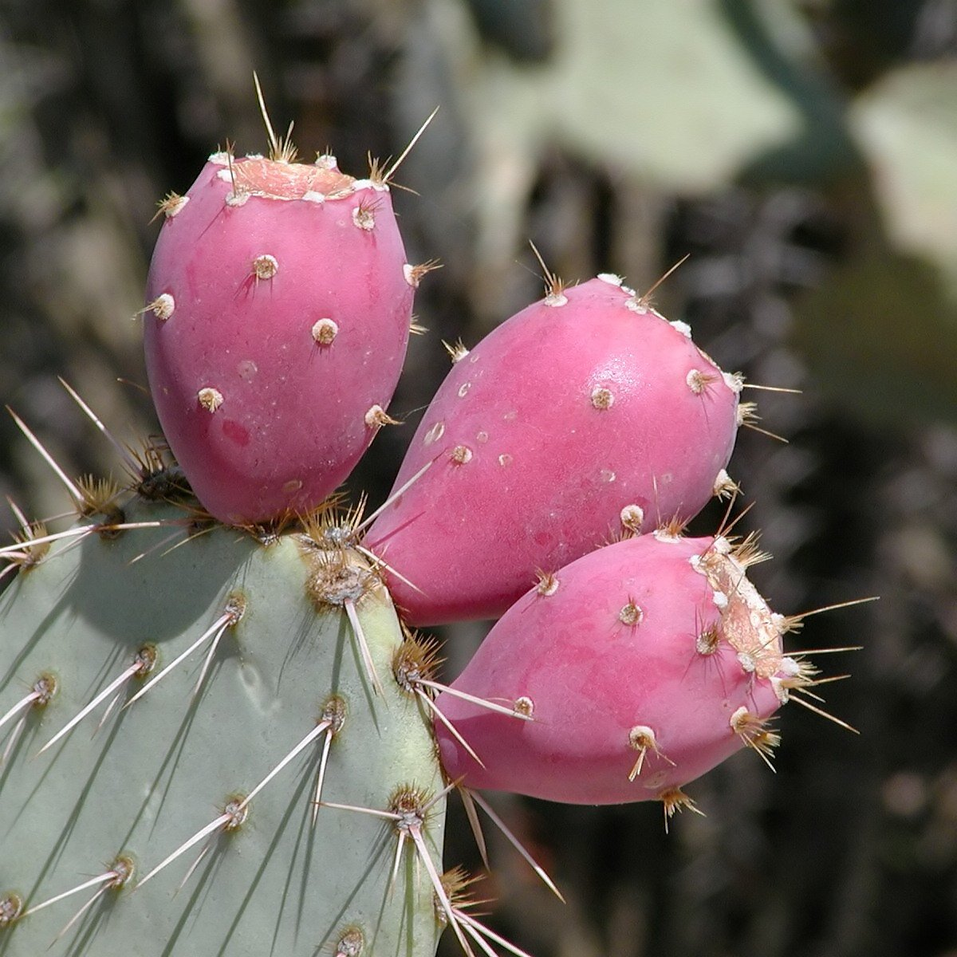
Seed Dispersal
Allocation theory

Slide 5
Big picture questions
How strong are bird interactions for cacti of different
species
reproductive characteristics
Pollinators
Seed dispersers

Slide 6
Chapter 1: Fruiting metrics in Cactaceae—A Meta-Analysis
Comprehensive review and analysis of fruit and seeds in Cactaceae
Synthesize reports on allocation theory
Research Questions:
Do larger cacti individuals within the same species produce more fruits and/or larger fruits?
Do larger cacti individuals within the same species produce more seeds and/or larger seeds?
Do larger fruits produce more seeds compared within the same species?

Slide 7
Methods
Search terms: “cact*”, “seed”, “fruit”, “allocat*”, and “size”
Must:
Published in last 5 years
Ecology in discipline
Report regression or correlation coefficient

Slide 8
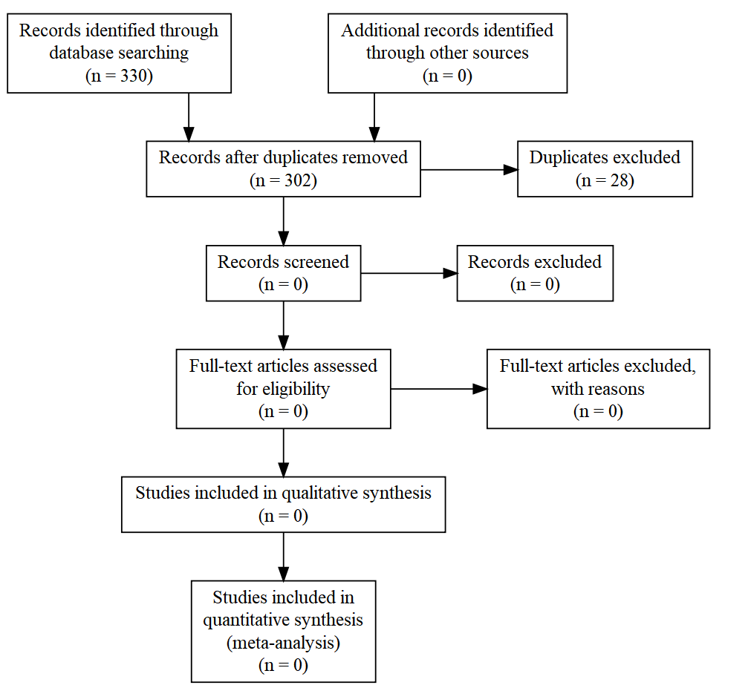

Slide 9
Chapter 2: Strength of birds as pollinators and seed dispersers in Cactaceae
Purpose:
Test strength pollinating and frugivorous birds to observed and experimentally manipulated characteristics of 3 taxa of cacti
Research Questions:
Is cactus size an indicator for fruit mass/abundance? For flower abundance?
Is there a positive relationship between number of seeds per fruit and fruit size in the cacti of interest?
Are frugivorous birds stronger dispersers for larger cacti?
Are pollinating birds (hummingbirds) optimally foraging at larger cacti?

Slide 10
Hypothesis & Predictions
Cacti size and flower, fruit, and seed production are positively related.
Larger cacti will produce more flowers, fruits, and seeds, as well as more massive fruits and seeds.
This will be true within species, but not between species.
Fruit mass and seed abundance are positively related.
Larger individual fruits will have more seeds than smaller fruits.
Frugivorous and pollinating birds optimally forage at cacti.
Birds will more frequently pollinate larger cacti, which have more flowers.
Birds will more frequently eat fruit at larger cacti, which have larger/more fruits.

Slide 11
Variables
Factors
Mesohabitat: Open/Cactus
Species
Size: Small, Medium, Large
Percent fruit/flower: 0%, 50%, 100%
Responses
Mass of individual fruits
Mass of individual seeds
Number of flowers per cactus
Number of fruits per cactus
Number of seeds per fruit
Species richness and diversity per cactus
Proportion of frugivorous birds present relative to non frugivorous birds

Slide 12
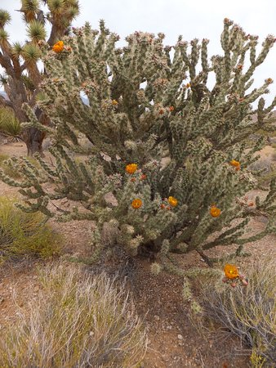
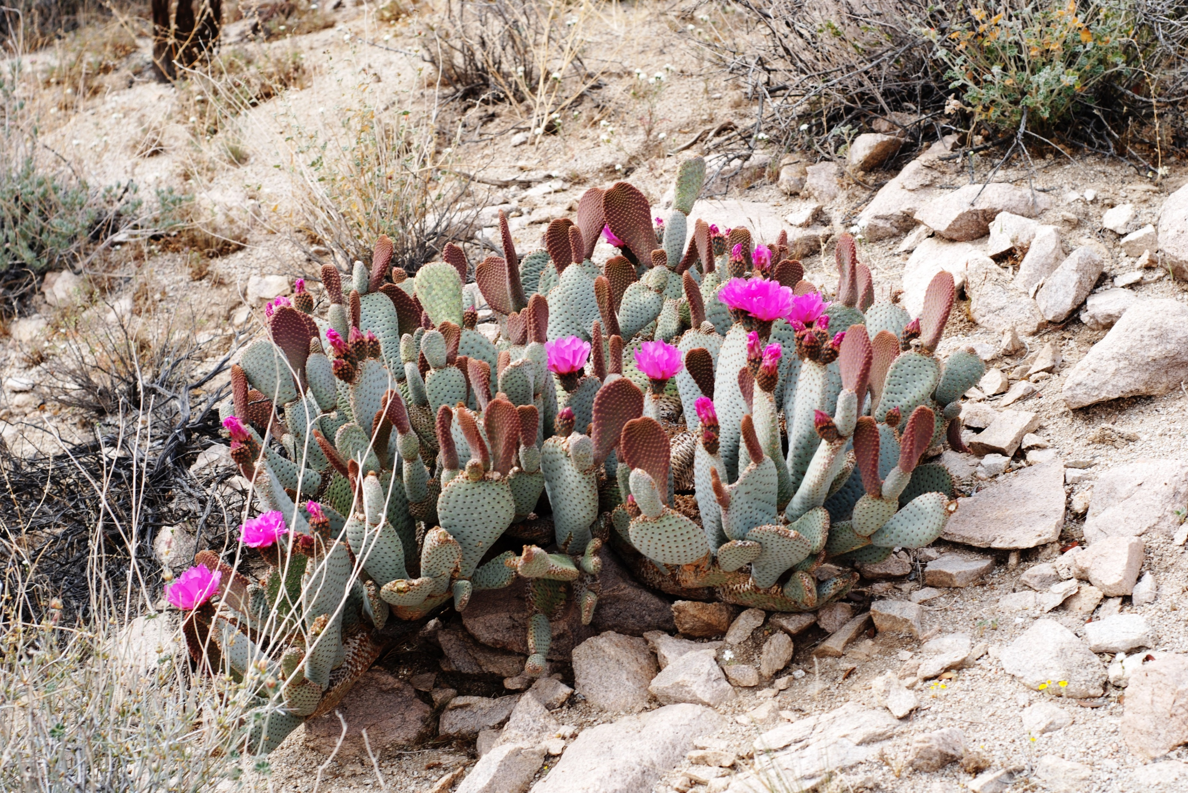
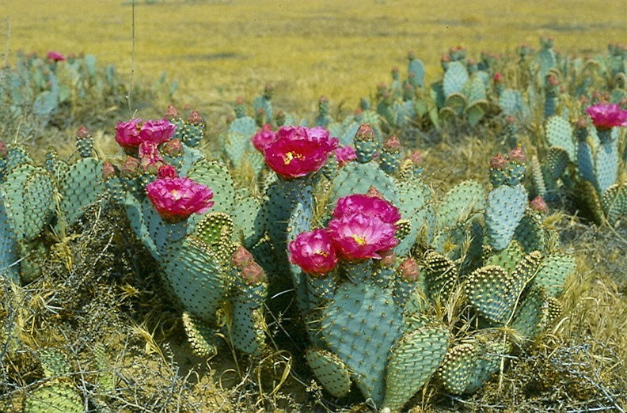
Study Species
Opuntia basilaris var. basilaris,
Beavertail
Opuntia basilaris var. treleasei,
Bakersfield Cactus
Cylindropuntia anthrocarpa,
Buckhorn Cholla
Photos: Beavertail By Jarek Tuszyński / CC-BY-SA-3.0, CC BY-SA 3.0, https://commons.wikimedia.org/w/index.php?curid=32296209, Bakersfield cactus https://www.fs.fed.us/wildflowers/Rare_Plants/profiles/TEP/opuntia_basilaris_treleasei/images/opuntia_basilaris_treleasei_lg.jpg, Buckhorn Cholla https://www.tripadvisor.com/LocationPhotoDirectLink-g45973-d12337276-i316774403-Gold_Butte_National_Monument-Mesquite_Nevada.html

Slide 13
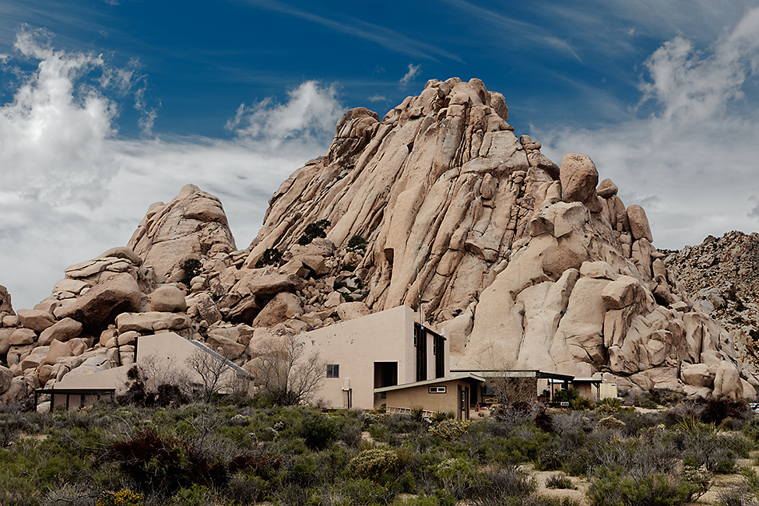
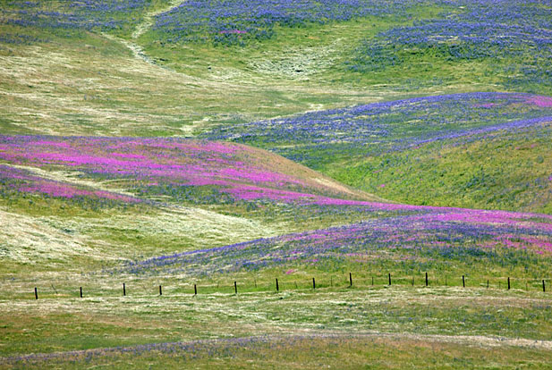
Study Sites
Sweeny Granite Desert Research Center:
O. basilaris var. basilaris & Cylindropuntia anthrocarpa
Wind Wolves Preserve
O. basilaris var. treleasei
http://www.paradise-fall.com/html/Wind+Wolves+Preserve

Slide 14
Methods: Site Metrics
Cactus density/diversity
Transects: 100m each, every 5m, 10m apart, 6 replicates
Bird density/diversity
1km transects
Every 7 days
All birds seen or heard
Cactus metrics
100 individuals of each species
Branching
X, Y, Z

Slide 15
Methods: Flowering Experiment
10 replicates of each combination of variables
270 total individuals
Showiness
Manipulated: 0%, 50%, 100% buds on cactus
Remove
Size
Small, medium, large
Binned after preliminary field season
Species
O. basilaris var. basilaris, O. basiliaris var. treleasei, C. anthrocarpa

Slide 16
Methods: Flowering Experiment
Focal observations
200-500mm digital camera
1 hour sessions in morning/evening
4 replications per variable combination and open
112 hours total
Ethogram
Audio recordings
Unidirectional audio recorder
Parabolic shield
ad libitum
Concurrent with focal observations

Slide 17
Methods: Fruiting Experiment
10 replicates of each combination of variables
270 total individuals
Showiness
Manipulated: 0%, 50%, 100% fruits on cactus
Collect in air-tight container to weigh and count seeds
Size
Small, medium, large
Binned after preliminary field season
Species
O. basilaris var. basilaris, O. basiliaris var. treleasei, C. anthrocarpa

Slide 18
Methods: Fruiting Experiment
Focal observations
1 hour sessions in morning/evening
4 replications per variable combination and open
112 hours total
Audio recordings
Camera traps
2 cameras at every combination of variables
One facing cactus, one facing open area
5 days left to photograph
After 5 days, camera moved to new cactus
5 reps (25 total days)

Slide 19
Paired Flower-Fruit Observations
Fruiting and flowering manipulations won’t be the same cacti
Possible that flowers won’t fruit, could lead to issues in fruiting season
Lat-long of 20 individuals of each species
x, y, z
Number of branches
Number of flowers -> fruit
Sucrose content of flowers (radiometer)
Establish flowering patterns impact on fruiting patterns of different cacti characteristics

Slide 20
Chapter 3: Avian pollination and seed dispersal influence on seed shadow of Cactaceae obligate protege plants
Purpose:
Test the importance of birds as pollinators/seed dispersers for cacti which are, at different life stages, beneficiaries and benefactors of facilitating plants and animals respectively.
Research Questions:
Does flower number predict fruit number?
Do larger cacti produce more flowers/fruits, or higher mass fruits than smaller cacti?
Do larger fruits produce more seeds, or higher mass seeds than smaller fruits?
Are frugivorous birds more frequent at for larger cacti?
Are pollinating birds (hummingbirds) optimally foraging at larger cacti?
Do birds produce seed rain in favorable habitats for germinating seedlings (under a benefactor shrub canopy)?

Slide 21
Hypothesis & Predictions
Hypothesis: Positive interactions between birds and cacti are the limiting factor in cacti distribution to the canopy of a benefactor shrub, with plant size and allocation being a determining factor in interaction strength.
Predictions:
a. Cacti reproduction effort is size-dependent, and fruit and seed size are positively correlated.
b. Bird visitation rates for pollination and frugivory are positively related to cacti size and floral display.
c. The bird-cacti relationship is species specific (both for bird and cacti species).
d. Frugivorous birds are perching in spaces for depositing seed rain in optimal germination habitats (under benefactor shrubs.)

Slide 22
Variables
Factors
Mesohabitat: Open/Cactus
Species
Size: Small, Medium, Large
Percent fruit/flower: 0%, 50%, 100%
Responses
Mass of individual fruits
Mass of individual seeds
Number of flowers per cactus
Number of fruits per cactus
Number of seeds per fruit
Species richness and diversity per cactus
Proportion of frugivorous birds present relative to non frugivorous birds
Frugivorous bird visitation rate at cacti and benefactor shrub
Species richness and diversity per benefactor shrub
Proportion of frugivorous birds present relative to other species per benefactor shrub

Slide 23
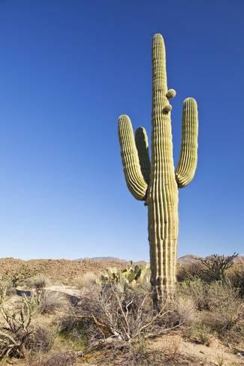
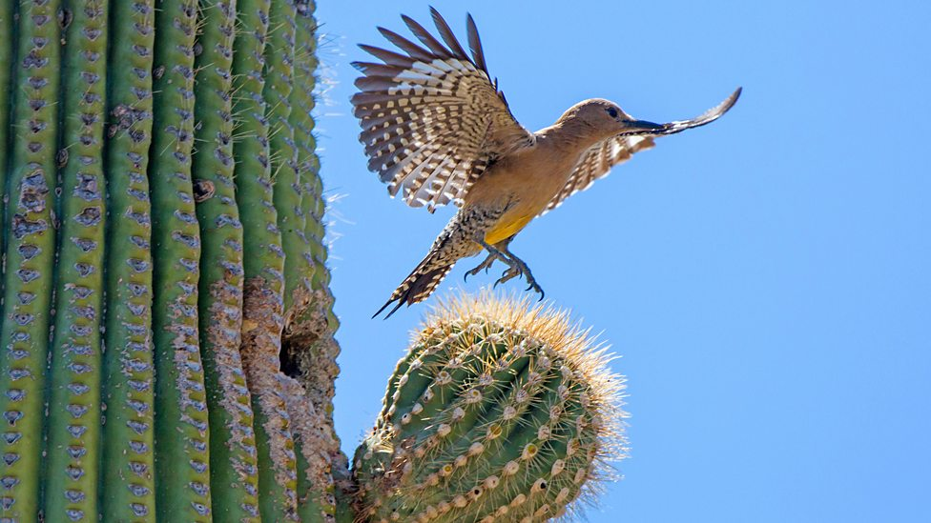
Study Species
Carnegiea gigantea,
Saguaro

Slide 24
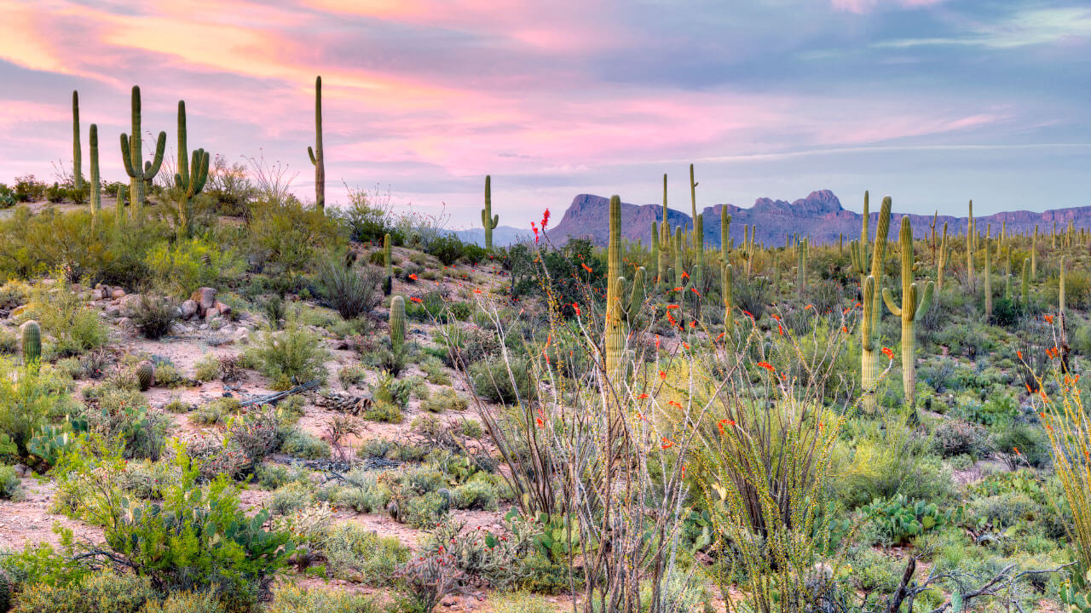
Study Sites
TBD Sites in Sonoran Desert
Arizona
Expedition with team to find Saguaro and shrub lands

Slide 25
Methods: Site Metrics
Cactus density/diversity
Transects: 100m each, every 5m, 10m apart, 6 replicates
Bird density/diversity
1km transects
Every 7 days
All birds seen or heard
Cactus metrics
100 individuals of each species
Branching
X, Y, Z
Same as Chapter 2

Slide 26
Methods: Flowering Experiment
10 replicates of each combination of variables
90 total individuals
Showiness
Manipulated: 0%, 50%, 100% buds on cactus
Remove
Size
Small, medium, large
Binned after preliminary field season
Species
Carnegiea gigantea

Slide 27
Methods: Flowering Experiment
Focal observations
200-500mm digital camera
1 hour sessions in morning/evening
4 replications per variable combination and open
40 hours total
Ethogram
Audio recordings
Unidirectional audio recorder
Parabolic shield
ad libitum
Concurrent with focal observations

Slide 28
Methods: Fruiting Experiment
10 replicates of each combination of variables
90 total individuals
Showiness
Manipulated: 0%, 50%, 100% fruits on cactus
Collect in air-tight container to weigh and count seeds
Size
Small, medium, large
Binned after preliminary field season
Species
Carnegiea gigantea

Slide 29
Methods: Fruiting Experiment
Focal observations
1 hour sessions in morning/evening
4 replications per variable combination and open
Audio recordings
Camera traps
2 cameras at every combination of variables
One facing cactus, one facing open area
5 days left to photograph
After 5 days, camera moved to new cactus
5 reps (25 total days)

Slide 30
Paired Flower-Fruit Observations
Fruiting and flowering manipulations won’t be the same cacti
Possible that flowers won’t fruit, could lead to issues in fruiting season
Lat-long of 20 individuals
x, y, z
Number of branches
Number of flowers -> fruit
Sucrose content of flowers (radiometer)
Establish flowering patterns impact on fruiting patterns of different cacti characteristics

Slide 31
Benefactor Shrub Canopy
Determine if frugivorous birds perch on benefactor shrubs
Randomly select 100 shrub individuals
Count number/proportion of saguaro juveniles:
Under shrub canopy versus in open
Camera traps
2 camera traps at paired shrub/open sites
5 days replicates, 25 days total
Focal Observations and Audio recordings
10 1-hour observations

Slide 32
Side/Future Projects
This project opens ideas for collaboration
Seed trays
Nutrition content of fruit
Seed predation after bird digestion
Team of 4-6 undergrad assistants
1 who would like to head up seed trays

